Slide 1
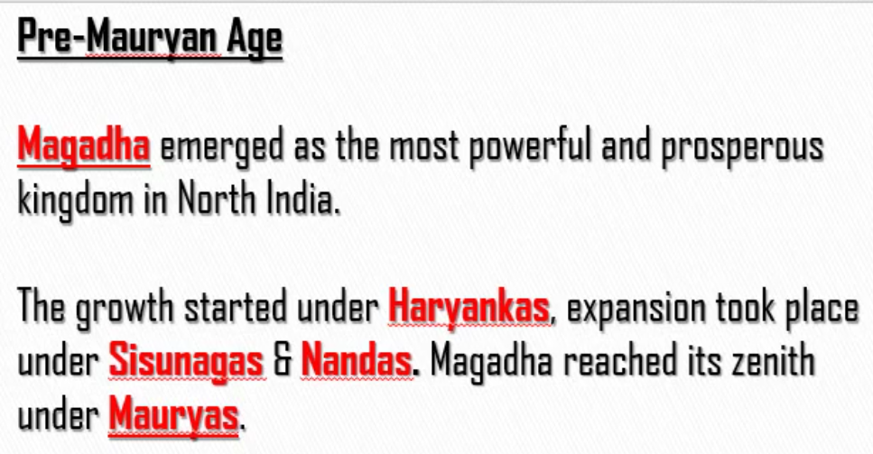
Magadha was ruled:
First by Haryankas
After the decline of Haryankas, Magadha was ruled by Sisunagas and Nandas
After Sisunagas and Nandas, Magadha was ruled by Mauryas. Under the rule of Mauryans, Magadha was in peak.

Slide 2
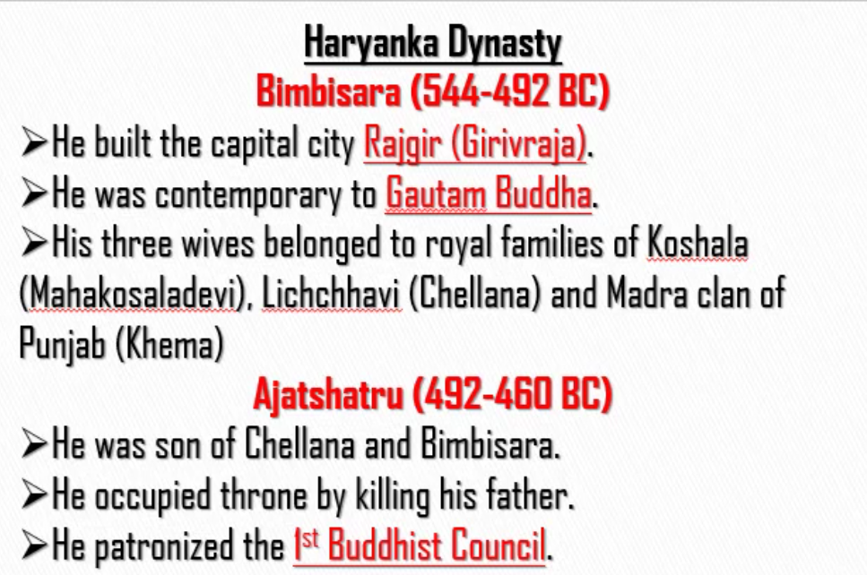
Wife Name of Bimbisara | Kingdom to which wife belonged
Mahakosaladevi | Koshala
Chellana | Lichchhavi
Khema | Madra Clan of Punjab

Slide 3
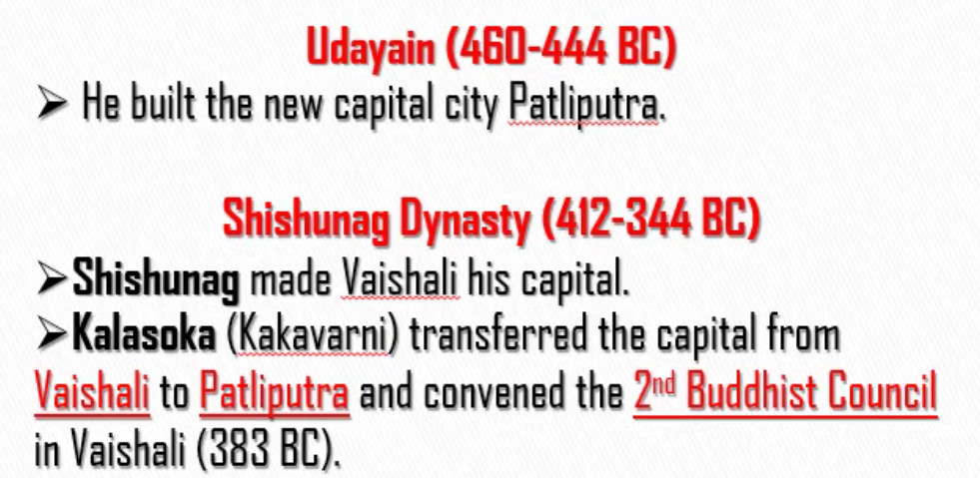
Kakavarni – Person who is black in colour (Karya – Kalapani)

Slide 4
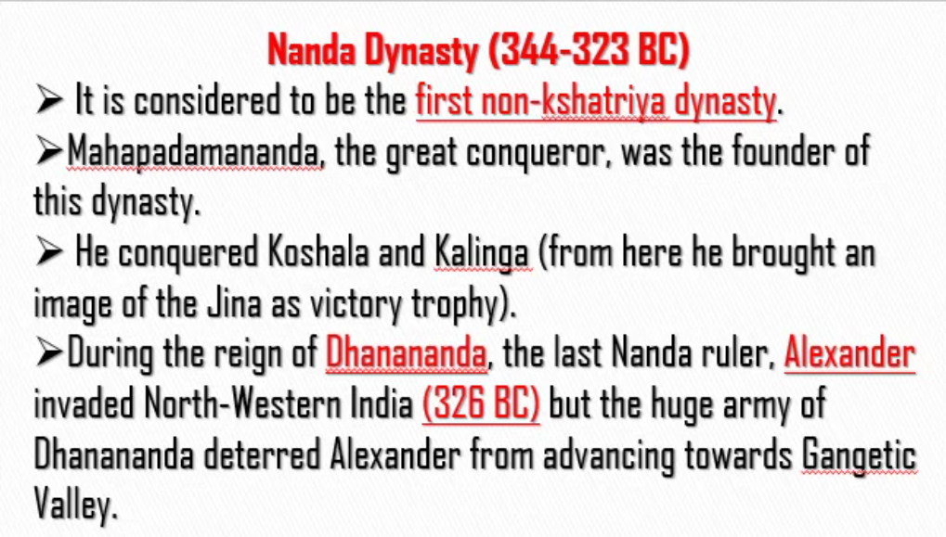
Dhanananda was killed by Chandra Gupta Maurya
Dhanananda was infamous for extracting high taxes from the people in his kingdom.
Dhanananda was the last ruler of Nanda Dynasty

Slide 5
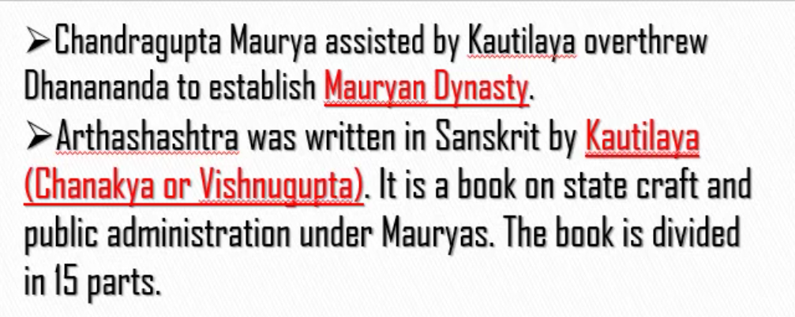

Slide 6
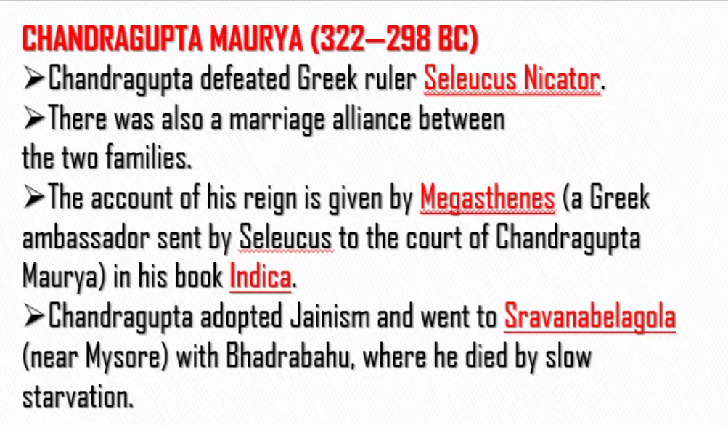
Chandragupta married the daughter of Seleucus and hence established the marriage relationship between two families.

Slide 7
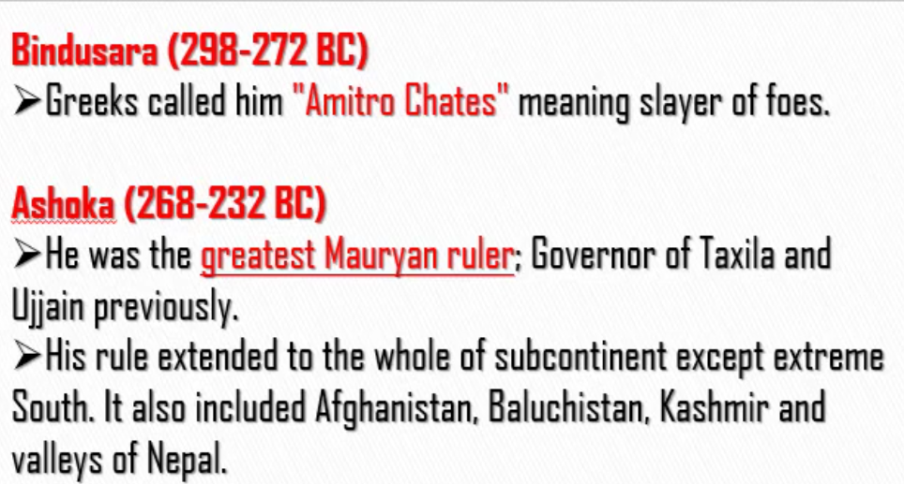
Slayer – Killer
Foes – Enemies
Ashoka was made the governor of Taxila and Ujjain by his father Bindusara

Slide 8
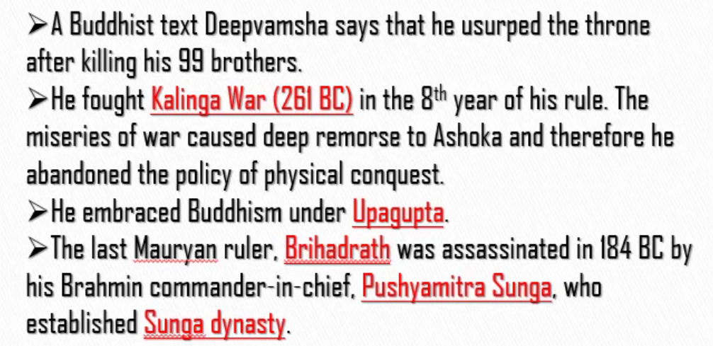
He – Ashoka
As he killed his 99 brothers, he is called Ashoka Vardhana
Chandragupta – Jainism Ashoka – Buddhism
Brihadrath – Last Mauryan ruler
Brihadrath was killed by his own commander in chief, Pushyamitre Sunga. Pushyamitra Sunga established Sunga dynasty.
Pushyamitra Sunga was brahmin.

Slide 9
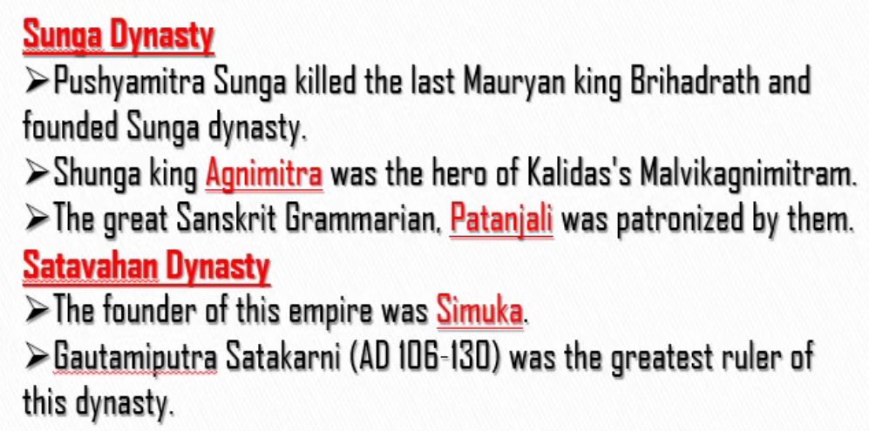
Them – Sunga rulers

